Slide 1
DATA ANALYST PORTFOLIO
Denise Olson
dcolson66@gmail.com

Slide 2
Project Case Studies
Game Co.
Market Analysis global video game sales.
Preparing for Influenza Season in US
Analysis performed to help healthcare organizations plan for influenza season.
Rockbuster Stealth
Market Analysis and response to business questions for online video rental company.
Instacart
Customer and marketing strategy analysis for online grocery store.
Final Project
Details coming

Slide 3
GameCo.
Project Objective
Perform descriptive analysis of video game data set to gain better insights to how GameCo’s new games will perform in the market. Respond to Executive team’s key questions regarding data.
Project Documents
GameCo Project Brief
GameCo Presentation
DataSet
Video Game Sales (1980-2016), Source -VGChartz
Software Tools
Excel
PowerPoint
Skills
Data Set understanding
Data Cleaning
Data grouping & summarization (Pivot Tables)
Analytical Methods
Descriptive Analysis/Developing Insights
Visualization (build bar & column charts, whisker & scatter plots)
Storytelling Data Presentation

Slide 4
GameCo. Analysis
Visualization 1 Shows five-year historic sales by geographic regions in millions Key Insight: Sales by geographic region have not stayed the same.
Visualization 2 Shows five-year Percentage of Market Share by Region Key insight: Europe is surpassing North America sales in 2016, and Japan sales are trending upward in 2016.

Slide 5
Visualization 3 Shows Sum of Genre Regional Sales Key Insight: Top Genre sales across all regions are Action, Shooter, Sports and Role-Playing
GameCo. Analysis

Slide 6
GameCo. Insights
North America and Europe regions top selling Genres (Action, Shooter, Sports)
Continue to allocate marketing dollars to top selling genres
Allocate additional marketing dollars to promote Role-Playing genre in these markets to try to generate additional interest /sales
Japan Region
Increase marketing dollars in top selling Genres of Action, Shooter, Sports to try to boost regional interest and sales
Continue to allocate marketing dollars to Role – Playing genre

Slide 7
Preparing for Influenza Season in US
Project Objective
Analysis of CDC and Census Historical Immunization Data to determine vulnerable populations, and where to send additional medical staffing resources for upcoming flu season.
Project Documents
Influenza Project Brief
Influenza Project Management Plan
Influenza Project Interim Report
Tableau Presentation
Vimeo Video Presentation
Dataset(s)
Influenza deaths by geography, time, age, and gender(2009-2017) – Source CDC
Population data by geography(2009-2017) – Source US Census Bureau
Software Tools
Excel
Tableau
Vimeo – video
Skills
Data Preparation & Analysis (Requirements. Project Plan)
Data Profiling & Integrity
Data Quality Measures, Transformation & Integrations
Statistical Analysis & Hypothesis Testing
Data Visualization & Storytelling (Tableau)
Composition & Comparison Charts
Statistical Visualization (Histograms, Box Plots, Scatter Plots, & Bubble Charts)
Spatial & Textual Analysis
Storytelling Data Presentation

Slide 8
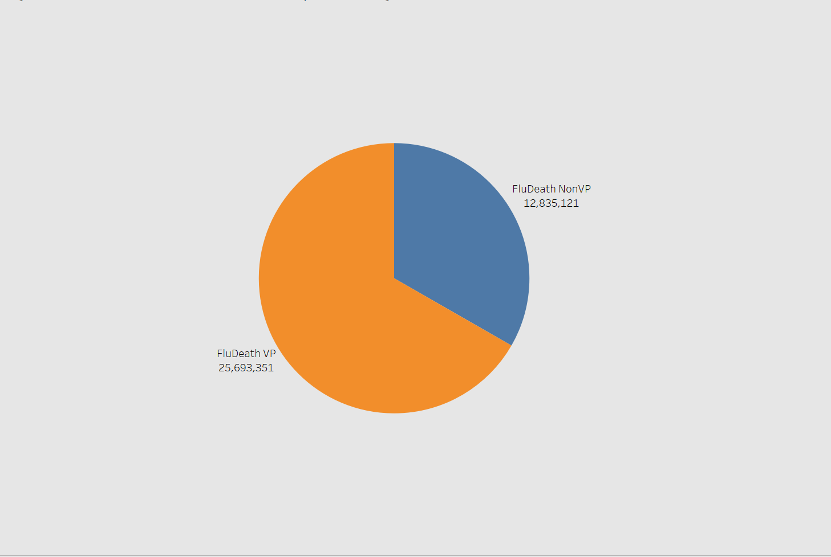
Influenza Season Analysis
Visualization pie chart displays total number of vulnerable and non-vulnerable population totals from 2009-2017
Planning for Influenza Season
If states have a high number of vulnerable populations and deaths due to flu, then hospitalizations will be greater and medical staffing needs will be higher in demand.
Vulnerable Population: Identified by CDC as children under 5 years and adults over 65 years.

Slide 9
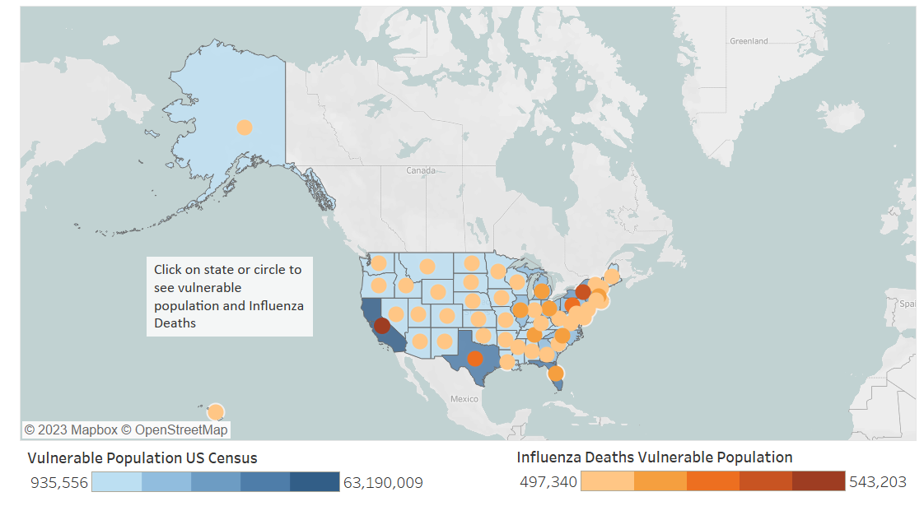
Influenza Season Analysis
States that have high numbers of vulnerable populations are impacted the most with influenza deaths (2009-2017)

Slide 10
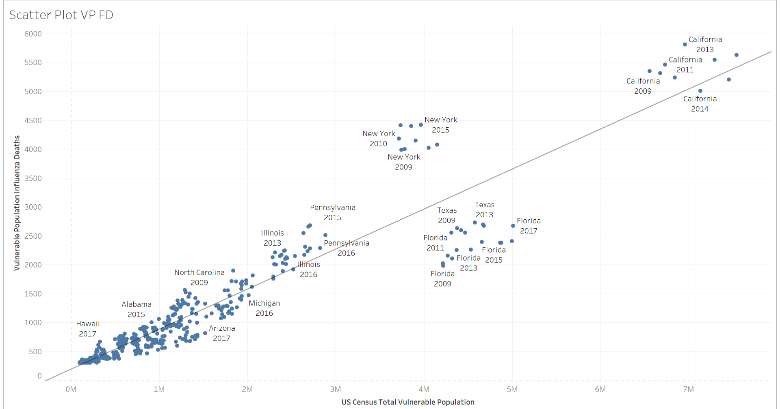
Influenza Season Analysis
This Scatter Plot map shows, as the vulnerable population number increases, the number of influenza deaths of vulnerable populations are expected to rise.

Slide 11
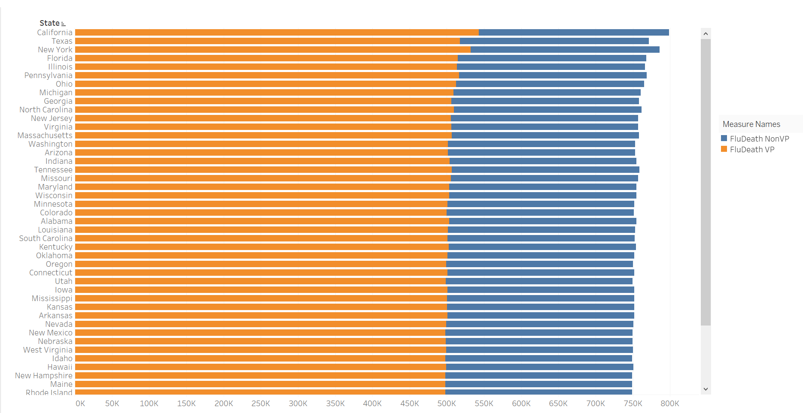
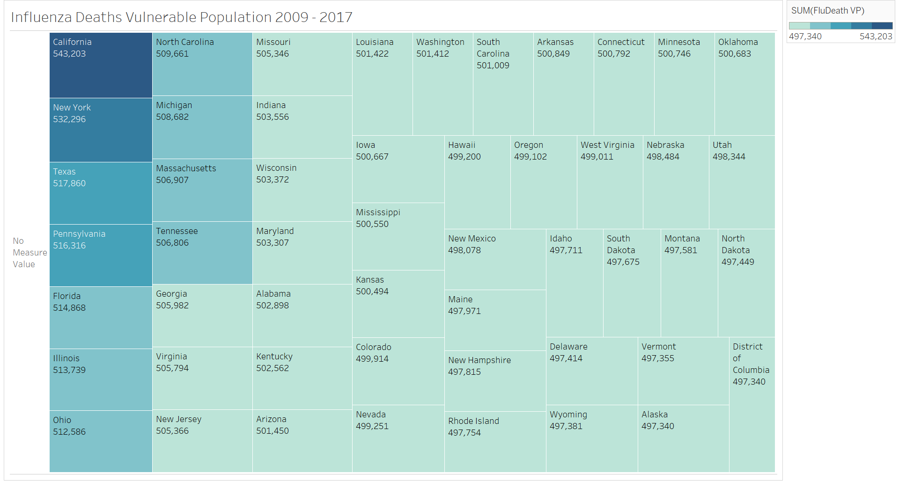
Influenza Season Analysis
States with have high numbers of Vulnerable Populations(VP) are impacted the most with influenza deaths (2009-2017)

Slide 12
Preparing for Influenza Insights
It can be concluded from the historic data and visualizations evaluated from the years of 2007-2019, which states consistently have high numbers of vulnerable populations and influenza deaths.
These states clinics and hospitals should further be consulted with to determine if during influenza season they will have additional medical staffing resource needs for the upcoming influenza season.

Slide 13
Rockbuster Stealth
Project Objective
Provide insights and answer several key business questions to leverage existing movie license to launch online video rental service.
Project Documents
Rockbuster Stealth Project Brief
Rockbuster Stealth Presentation
Rockbuster Stealth Data Dictionary
Dataset(s)
Dataset loaded into PostgreSQL
Contains information about Rockbuster’s film inventory, customers, and payments.
Software Tools
Excel
PowerPoint
Tableau
PostgreSQL
Skills
Relational Databases
Structured Query Language (SQL)
Summarizing and cleaning Data in SQL
Table Joins, Performing Subqueries
Common Table Expressions(CTE’s)
Visualizations of SQL results and Presentation

Slide 14
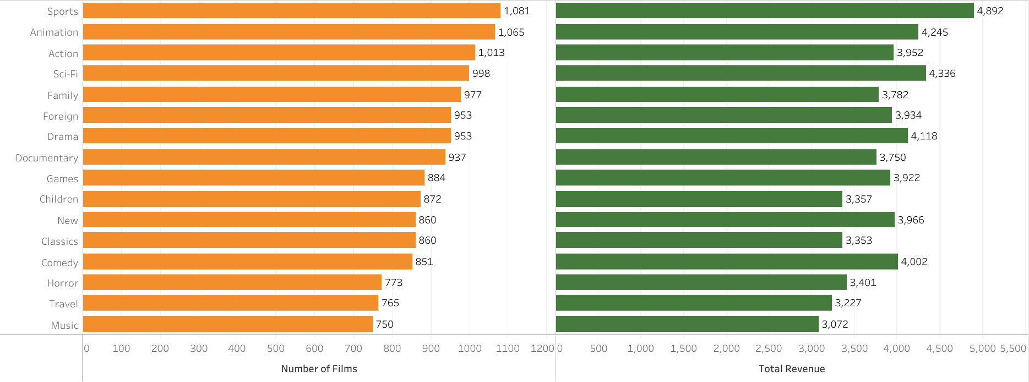
Rockbuster Stealth Analysis
Top performing Genre’s by number of films and total revenue. Top 5 Genre’s (Sports, Animation, Action, Sci-Fi, and Family) make up 35% of total rental revenue.

Slide 15
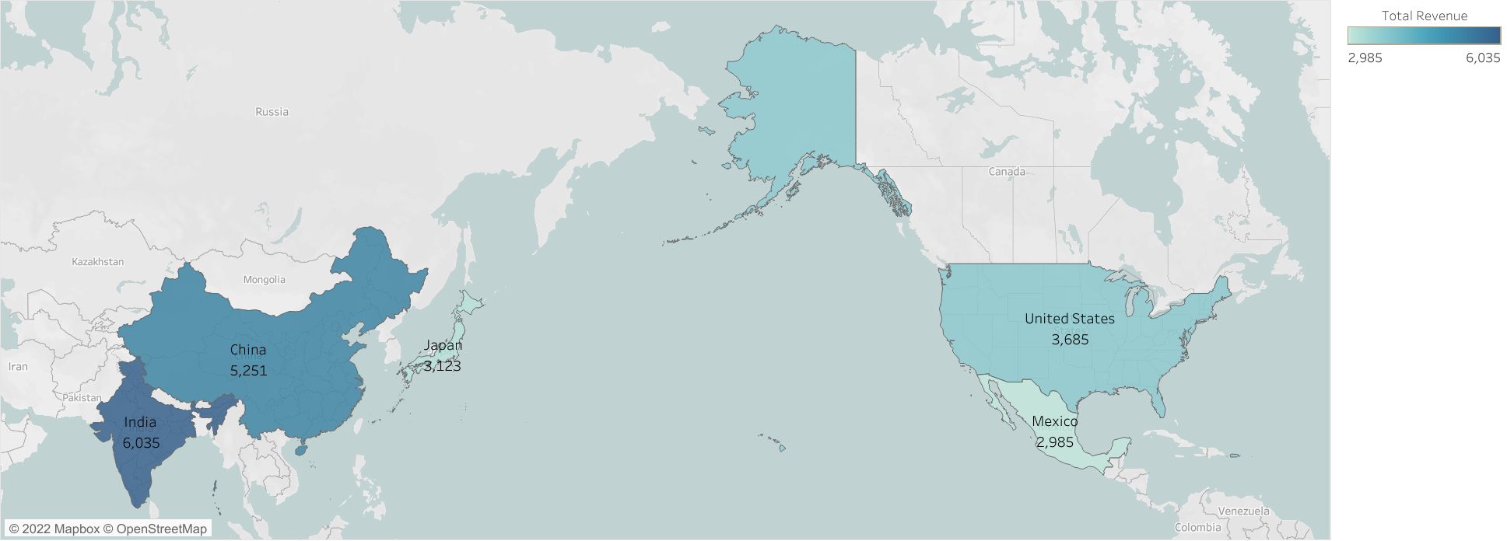
Rockbuster Stealth Analysis
Top Countries in Revenue are India $6035, China $5251, United States $3685, Japan $3123 and Mexico $2985

Slide 16
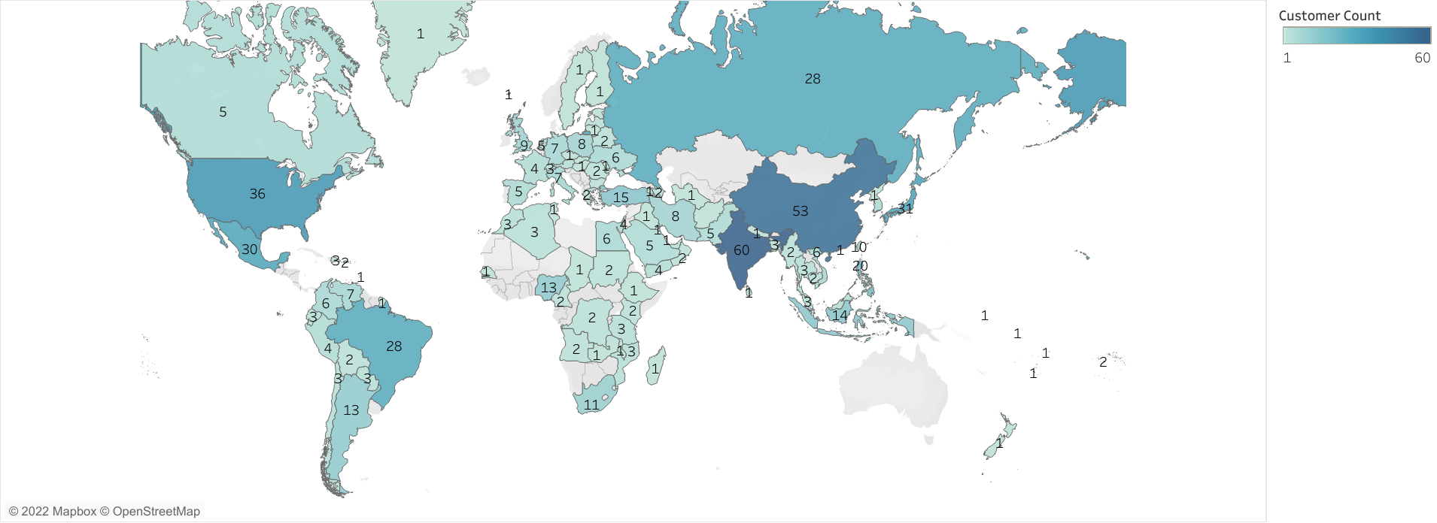
Rockbuster Stealth Analysis
Top Countries Customer count are India 60, China 53, United States 36, Japan 31 and Mexico 30

Slide 17
Rockbuster Stealth Insights
Rockbuster Stealth Management team should focus making new streaming services available to existing top performing countries.
Create marketing campaign to target locations with high revenue count.
Focus on promoting Sports, Animation, Action, Sci-Fi, and titles for they are the most popular.

Slide 18
Instacart Grocery Store
Project Objective
Perform data and exploratory analysis to derive insights and suggest strategies for better segmentation based on customers online ordering behavior.
Project Documents
Instacart Project Brief
Instacart Final Report
GitHub Repository (for both Rockbuster Stealth & Instacart Grocery)
Dataset(s)
Open-source data sets from Instacart's online ordering, Includes, “customers”, “orders” and “products”
Instacart
Software Tools
Excel
Anaconda & Jupyter
Python, Python datatypes & libraries
Pandas
Matplotlib
Seaborn
Skills
Data Exploring
Data Wrangling & Subsetting
Data Consistency checks, Cleaning, & Merging
Combining & Exporting Data
Deriving New Variables
Data grouping &Data Aggregating
Data Visualization with Python and presentation
Coding Etiquette & Excel Reporting

Slide 19
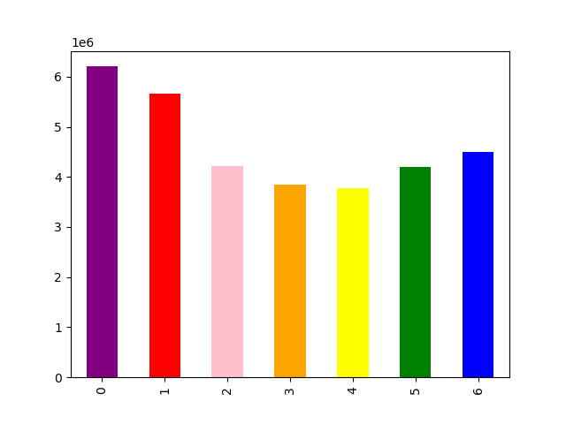
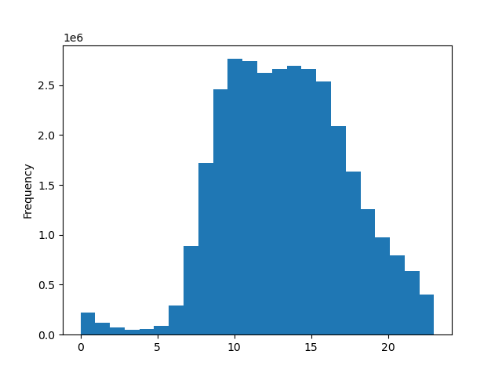
Instacart Analysis
Peak days / hours. Bar chart shows the busiest days are Sat., Sun. and Friday, while the histogram shows that the most orders are placed between 8am and 7pm.
LEGEND
0 = Saturday
1 = Sunday
2 = Monday
3 = Tuesday
4 = Wednesday
5 = Thursday
6 = Friday
This bar chart represents the days of the week when orders are placed. The busiest days are Saturday., Sunday and Friday.
This histogram represents what hours orders are being placed hourly. The busiest hours of the day are between 8am and 7pm.

Slide 20
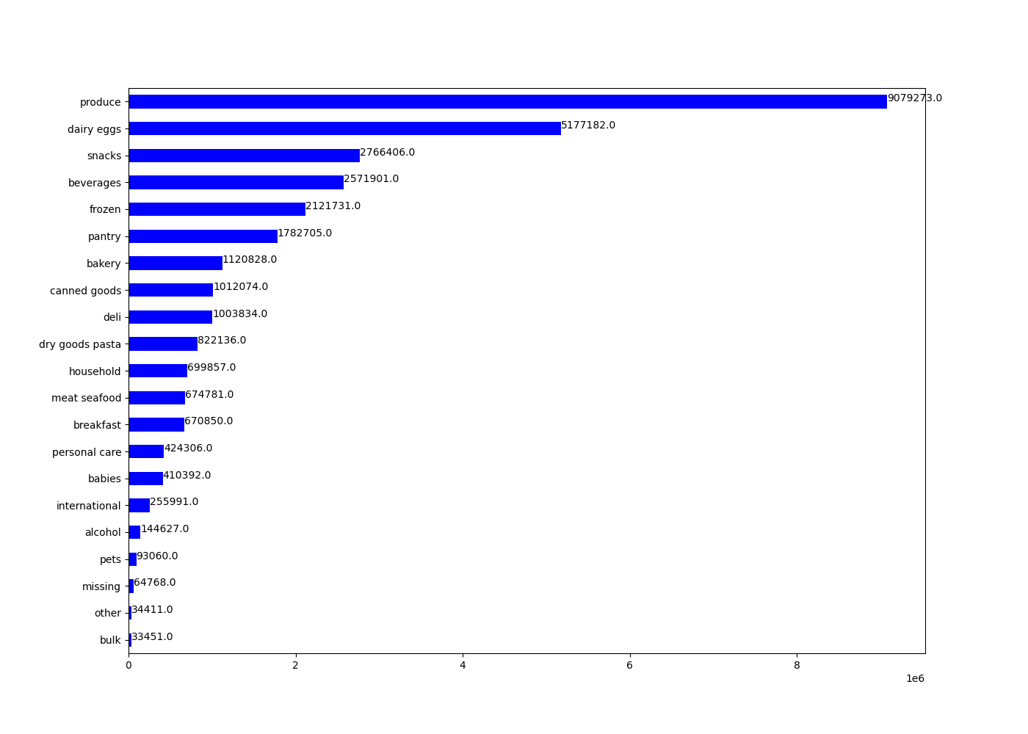
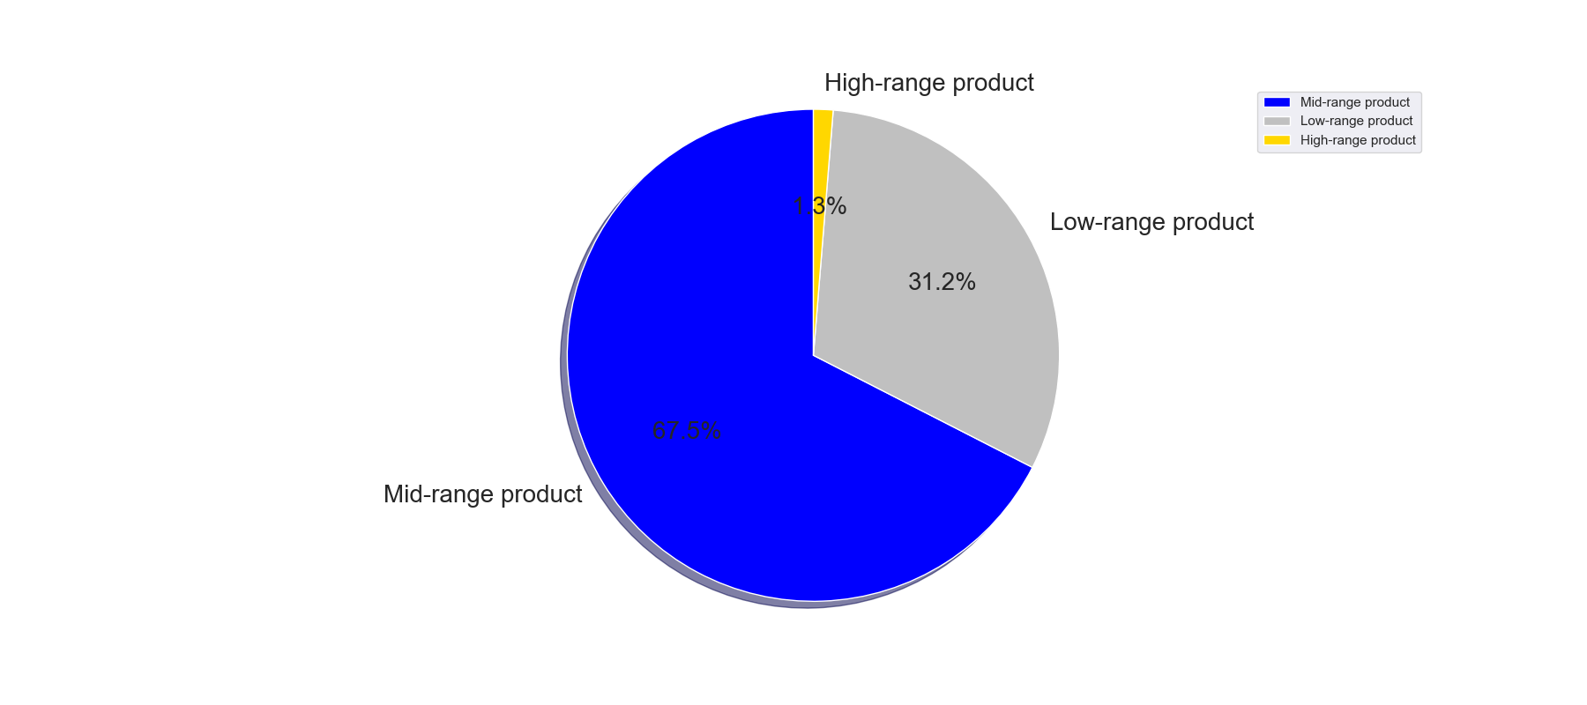
Instacart Analysis
The bar chart shows the 5 product departments with highest frequency of product orders are produce, dairy eggs, snacks, beverages, and frozen. Instacart has a lot of products with different price tags, the below pie chart shows price ranges from low, mid and high to help understand customer ordering.
Price ranges were sorted by low-range, mid-range and high-range product categories. Pie Chart
displays the proportions of each category.
If product is $5 it is considered low range product
If product price is > $5 but <= $15 mid range product
If product price is > $15 it is considered high range product

Slide 21
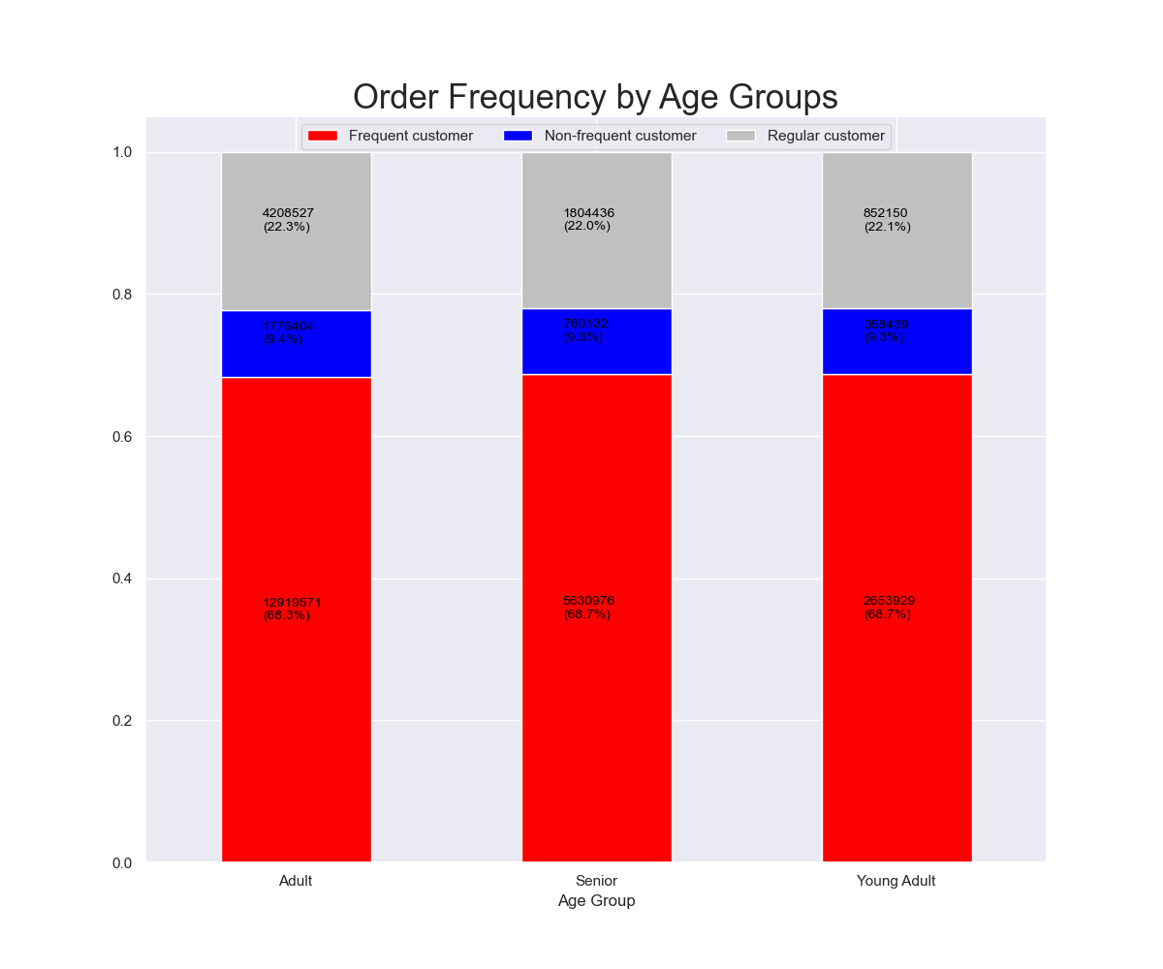
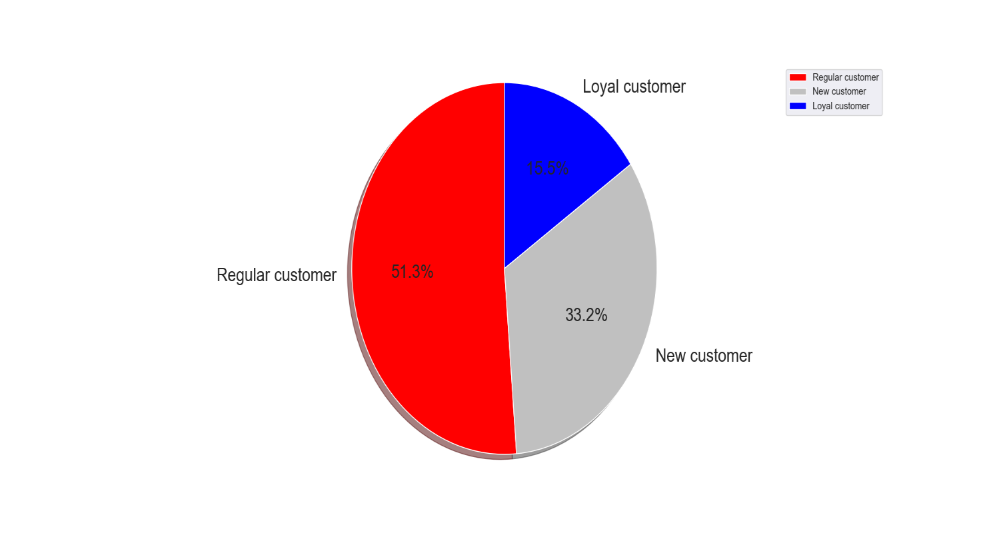
Instacart Analysis
Instacart customer base segmented by age group and order frequency and customer loyalty
The above stacked bar chart shows order frequency by age groups. The distribution among each group is nearly the same. Age Group is defined by:
Age <= 25 = Young Adult
Age > 25 and <65 = Adult
Age >= 65 = Senior
Customers are ranked as New, Regular and Loyal based on:
Max order <= 10 = New Customer
Max order >10 but <= 40 = Regular Customer
Max order > 40 = Loyal Customer

Slide 22
Instacart Insights
For peak shopping days and times, Instacart marketing team should promote Ads and incentives to encourage ordering outside of busy days and hours.
Top 5 product departments with highest frequency of product orders are produce, dairy eggs, snacks, beverages and frozen. Marketing can focus on the top 5 product departments but also can try to use ads to increase sales of some lower departments like alcohol and personal care.
To increase ordering of different products, could have target ads marketing the low and higher range products to try to increase sales across each age and marital status group. Marketing should focus advertisements to regular and new customers to increase max orders for them to become loyal customers.

Slide 23
Project Objective
Conduct exploratory analysis of boat data to examine which variables, specifically country, price in EURO’s, length and width may impact the number of views a boat receives.
Project Documents
Boat Views Analysis Tableau
GitHub Repository
Dataset(s)
Dataset sourced and provided by Kaggle (boat_data.cvs)
Kaggle boat_data
Software Tools
Excel
PowerPoint
Tableau
PostgreSQL
Python, Python datatypes & libraries
Quandl
Pandas
Numpy
Seaborn
Matplotlib, Matplotlib.pyplot
Statsmodel.api
Folium
Plotly
Quandl
Anaconda & Jupyter
GitHub
Skills
Sourcing Open Data
Exploring Relationships (scatterplots, correlation heatmaps, pair plots& categorical plots)
Geographical Visualizations
Supervised Machine Learning: Regression
Unsupervised Machine Learning: Clustering
Sourcing & Analyzing Time Series Data
Creating Data Dashboard
Boat View Analysis

Slide 24
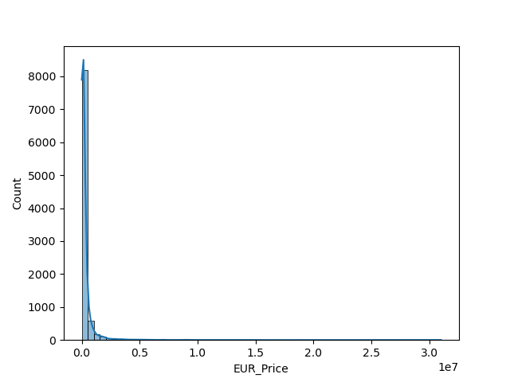
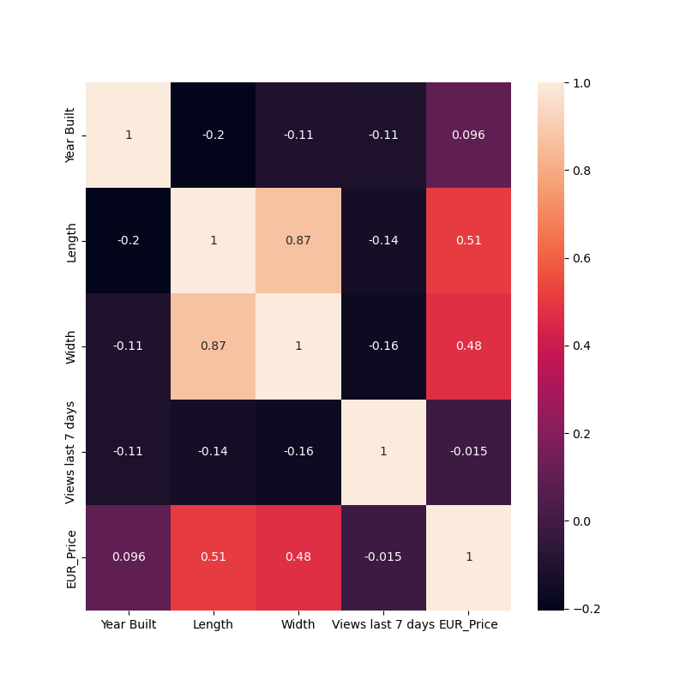
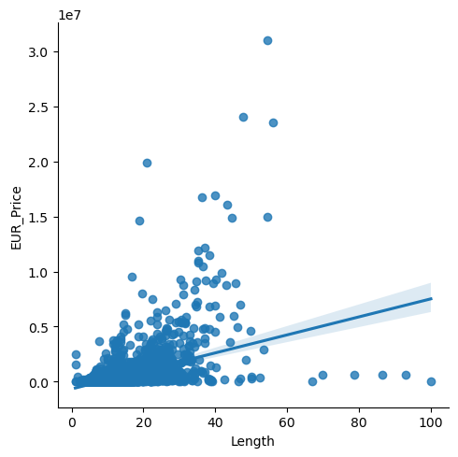
Exploratory Data Analysis
Exploring the dataset using Python
Finding connections between variables
Formulating and testing hypothesis with analytical approaches

Slide 25
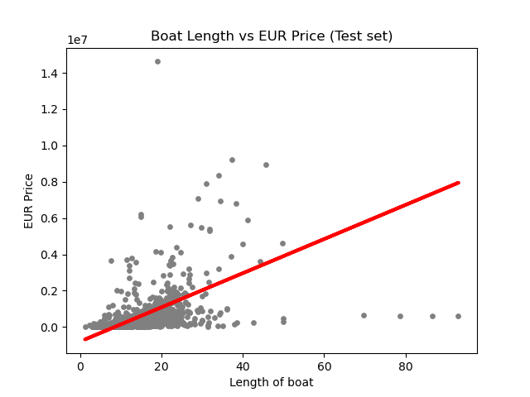
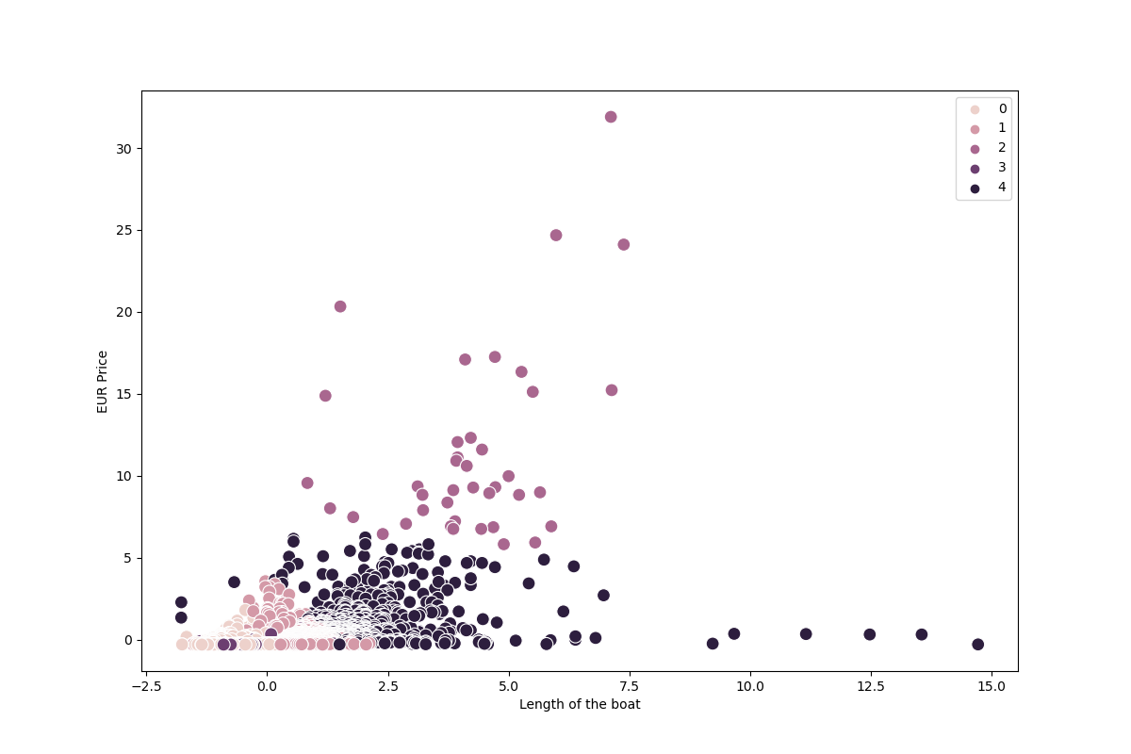
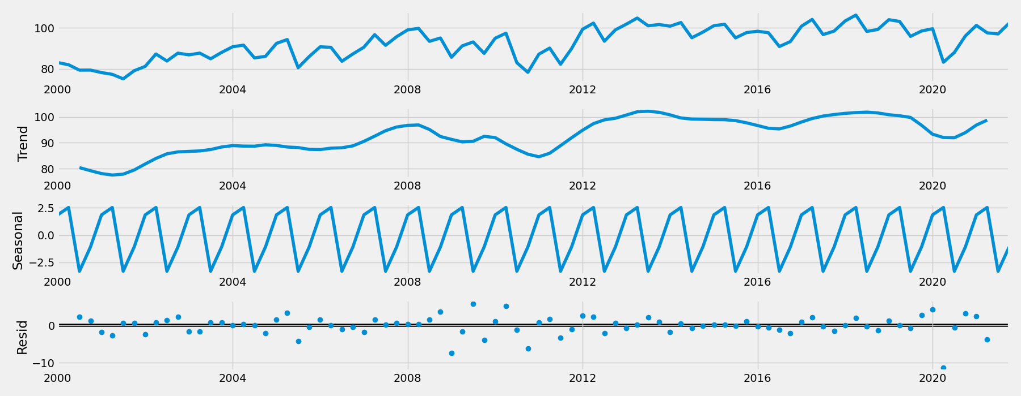
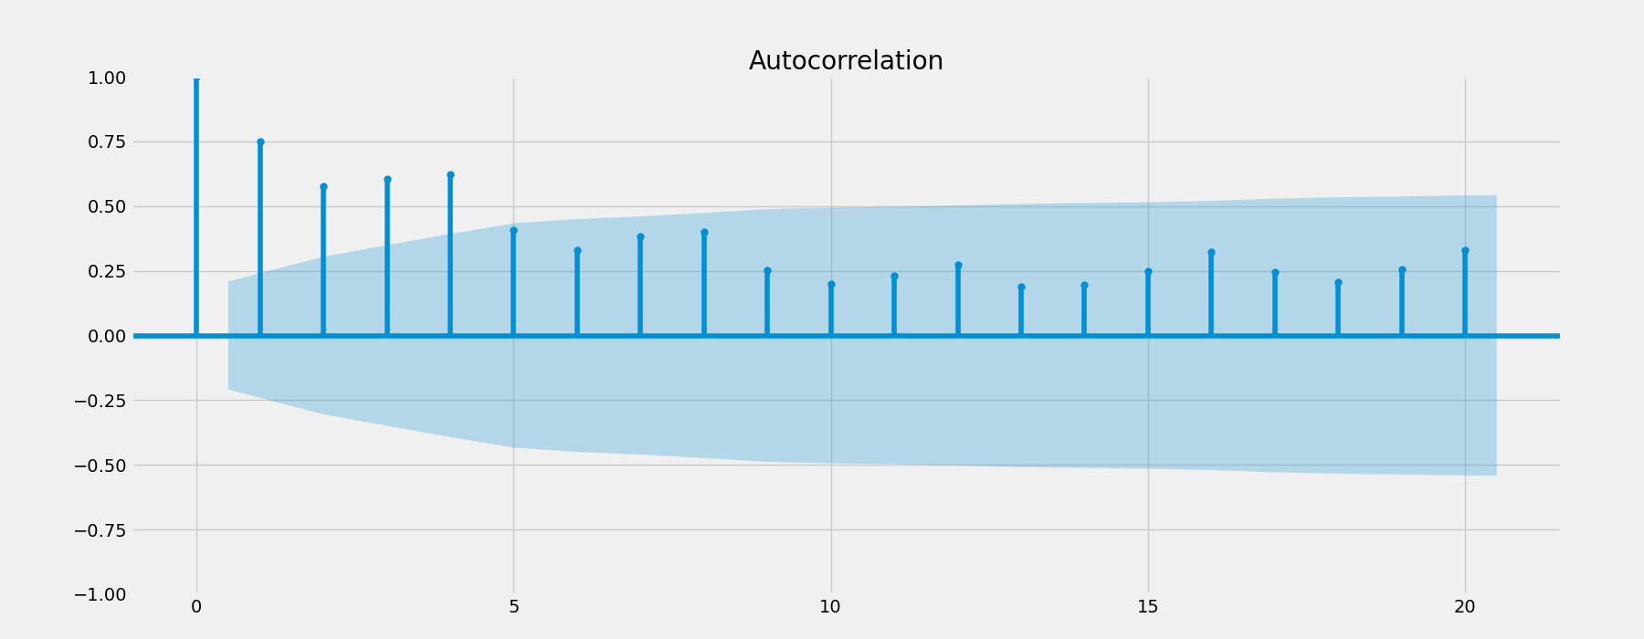
Machine Learning &Time Series Analysis
Using Machine learning Analysis to examine:
Linear Regression
K-means Clustering
Time Series

Slide 26
Boat View Insights
In analysis of the boat data and variables of Euro Price, Length, and Width there is no apparent relationship with the number of views a boat receives.
In determining which factors impact views and price of boats other variables need to be considered which may include age, material, boat model, location etc., of the boat.
Recommendation is for additional analysis performed to help gain better insight to what other variables may impact the number of boat views.

